Slide 1


Session 2 Image Processing

Slide 2
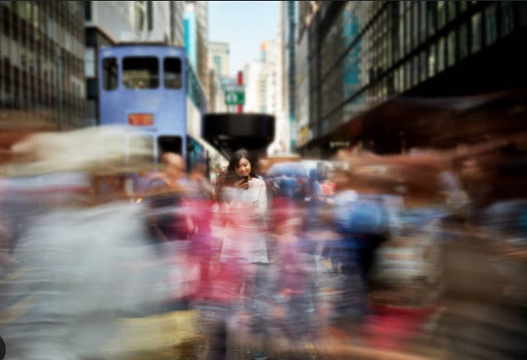
Today, We will talk about:
1-Blurring
2-Sharpening
3-Edge Detection

Slide 3
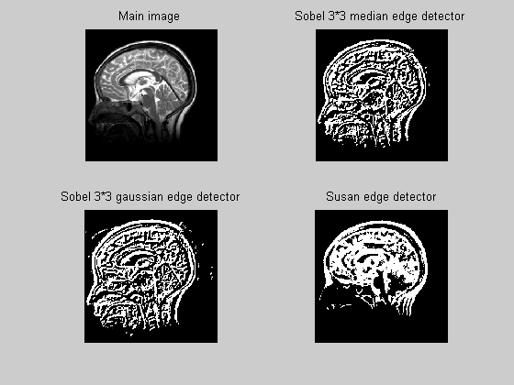
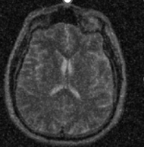
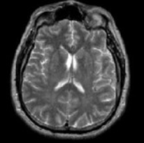
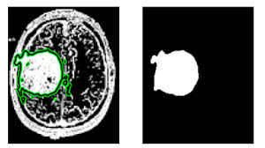
Why they’re important in our life?
Filters like Gaussian blur remove noise and small artifacts, making it easier to detect tumors, blood vessels, or other anatomical structures by making the edges more distinct.
Edge detection algorithms (e.g., Sobel, Canny) are used to outline the boundaries of different structures, making it easier for radiologists to identify abnormalities.

Slide 4
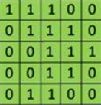


First of All, Let’s define what is kernel Convolution?
It is just a process where we take a small grid of numbers and we pass them over the whole image , transforming it based on what those numbers are. And by using different numbers in the kernel, we can perform blurs, or sharpen or edge detection.
Result
Input Image
Kernel

Slide 5
A small Animation for what happens

Slide 6


What is Blurring? As You let each pixel’s value blend into the pixel’s next to it. When you blur an image, You’re setting a pixel’s value to no longer be independent ,but be the average of the pixel’s values around it in a local neighborhood.

Slide 7
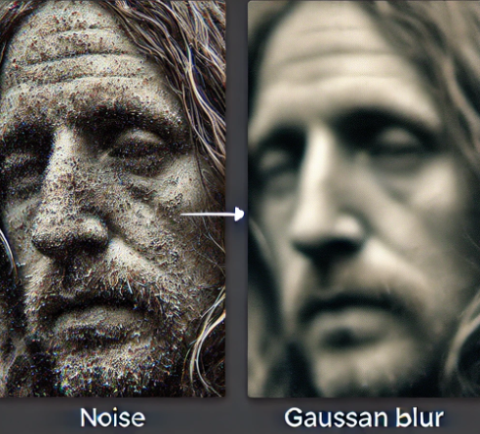
What is the importance of blurring?
• Noise Reduction
• Image Smoothing
It is a process that makes the image less sharp and reduces its level of detail.

Slide 8
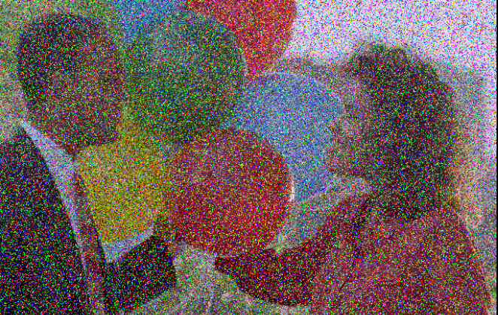
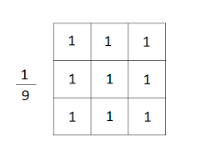
Types of Blurring
Salt and Pepper Noise
1-Average Blur : also known as Mean blur, works by replacing each pixel in an image with the average value of the pixels within a defined neighborhood around it
2-Gaussian Blur: It uses a Gaussian function (a bell-shaped curve) to determine the weights of the pixels within the neighborhood. Pixels closer to the center of the neighborhood have a higher weight, while those farther away have a lower weight
3-Median Blur : It replaces each pixel’s value with the median value of the pixels in a surrounding neighborhood . It is less sensitive to outliers, making it effective at removing "salt-and-pepper" noise.
Average Blur Kernel

Slide 9
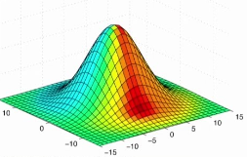
But , We Focus Mainly on Gaussian Blur As it is the MOST USED!!
It is the most common Blur as it is more controlled and edge preserving than other blurs.
a Gaussian blur, the pixels nearest the center of the kernel are given more weight than those far away from the center. The rate at which this weight diminishes is determined by a Gaussian function, hence the name Gaussian blur.
The end result is that our image is less blurred, but more “naturally blurred,” than using the average method. Furthermore, based on this weighting we’ll be able to preserve more of the edges in our image as compared to average smoothing.

Slide 10

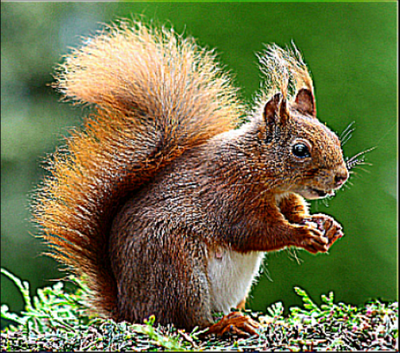
So, Now let’s talk about sharpening

Slide 11
What is Sharpening?
Sharpening is the opposite of Blurring an image

Slide 12
What is the importance of sharpening?
Enhance edges and details: Sharpening techniques work by increasing the contrast along the edges of objects within an image. This process makes the edges more pronounced, helping to distinguish different elements of the image more clearly.
Blur Reduction: While sharpening cannot completely remove motion blur, it can reduce its impact, making the image appear more focused and clear.

Slide 13

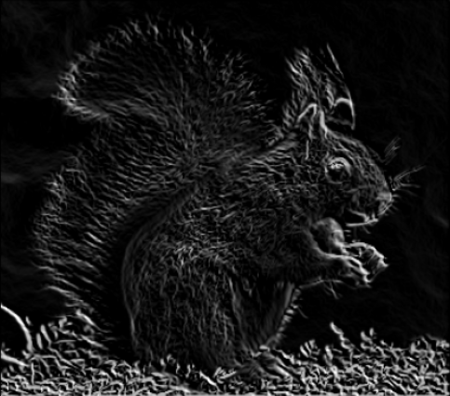
Finally, It is time for Edge Detection!

Slide 14

What is Edge Detection?
It is simply a case of trying to find the regions in an image where we have a sharp change in intensity or in color . As the greater change in intensity, the more likely that that portion of the image represents an edge.
There are three types of Edge detection:
1- Laplacian detection
2- Sobel Detection
3-Canny Detection (Best one)

Slide 15
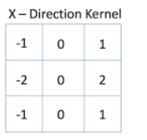
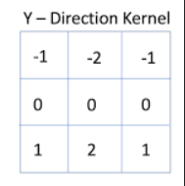
Sobel Filter
.
Sobel X: helps to emphasize vertical edges by calculating the gradient in the horizontal direction
Sobel Y: helps to emphasize Horizontal edges by calculating the gradient in the vertical direction
The results of Convolution:
Positive Values: Indicate that the pixel is part of an edge where intensity increases from left to right or from up to down.
Negative Values: Indicate that the pixel is part of an edge where intensity decreases from left to right or from up to down.
Zero Values: Indicate areas where there is little to no change in intensity in the horizontal direction

Slide 16
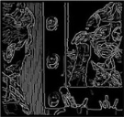
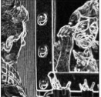
Canny Filter
Canny
Sobel
It works by taking the image from the Sobel output and thinning all the edges so they are 1 pixel wide.
Then , It applies a threshold to differentiate between strong and weak edges, and it tracks these edges to form continuous, well-defined edges throughout the image.
This final output highlights the strongest edges, giving a clean and accurate edge map of the image

Slide 17
Thank you!!

